Slide 1

COMP 5350 / 6350 / 6356 Digital Forensics Spring 2019

Slide 2
Forensics Testing Environment Setup

Slide 3
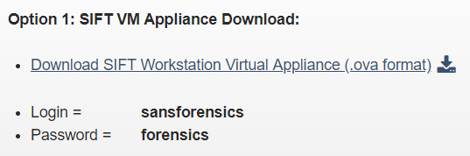
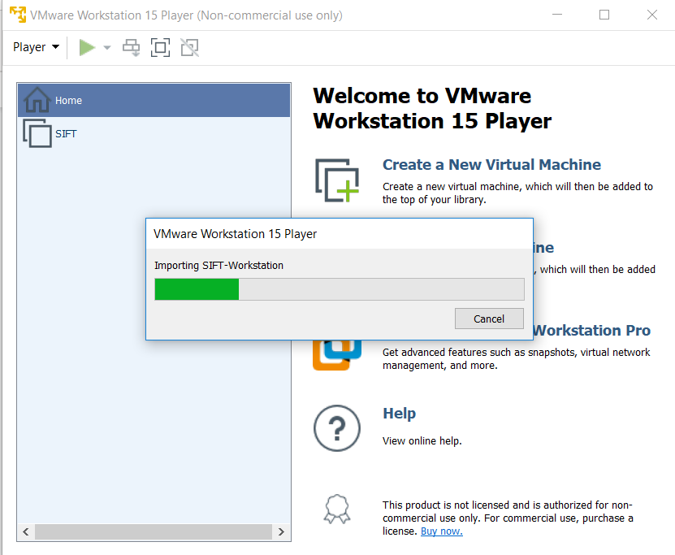
SIFT Installation - OVA

Slide 4
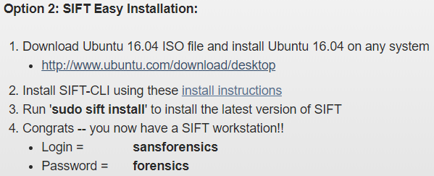
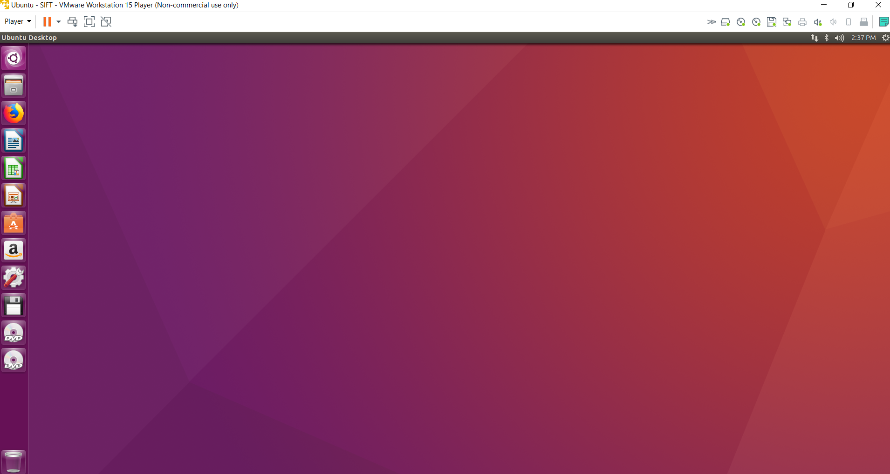
SIFT Installation - Ubuntu

Slide 5
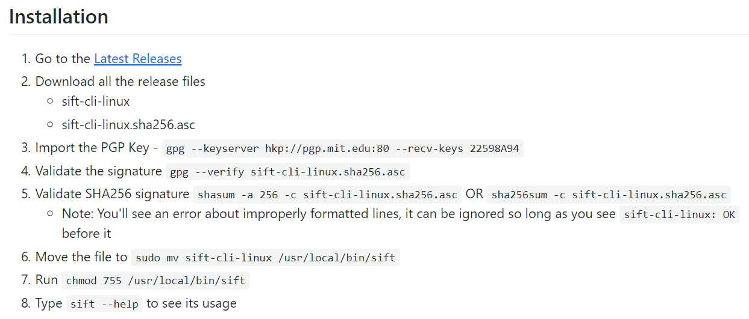
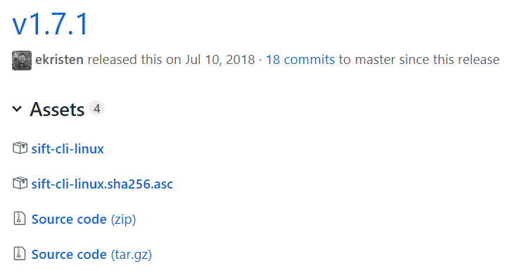
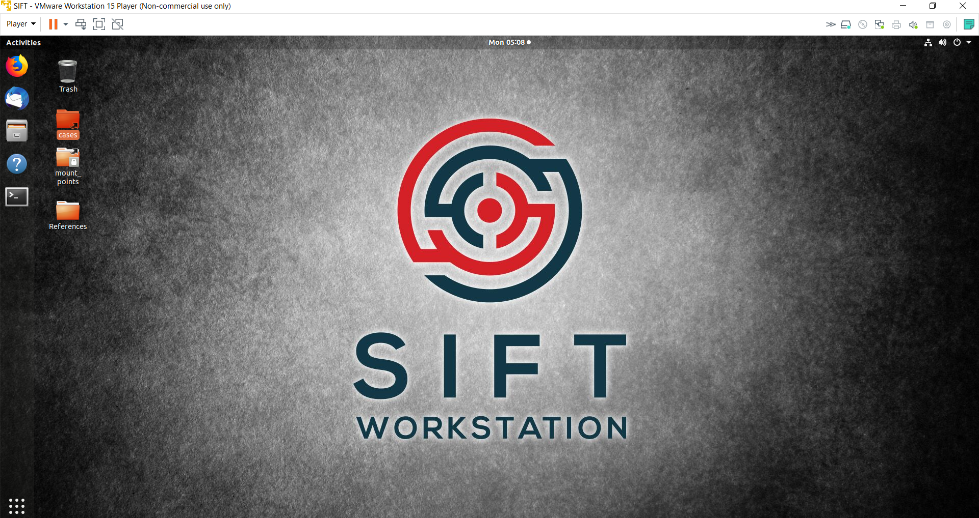
SIFT Installation - Ubuntu

Slide 6
Virtualization Definitions
Hypervisor - A software, firmware, or hardware solution that creates and runs virtual machines
Hypervisors can be run in 2 different configurations:
Type I: Bare Metal
Runs independent of the operating system
Type II: Hosted
Dependent on the operating system
Host – Hardware that a Type I or Type II hypervisor is running on
Guest – Virtual machine running on a hypervisor

Slide 7
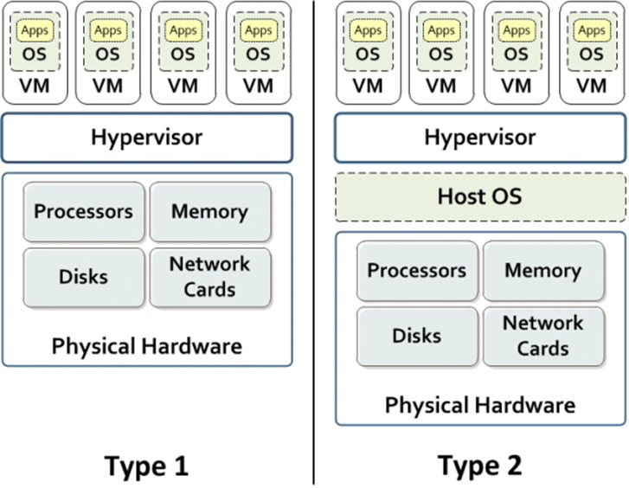



Type I Hypervisor
http://www.ibm.com/developerworks/websphere/techjournal/1506_dejesus/1506_dejesus-trs.html

Slide 8




Type II Hypervisor
http://www.ibm.com/developerworks/websphere/techjournal/1506_dejesus/1506_dejesus-trs.html

Slide 9




Hypervisor Type Examples
Keep in mind that SYS-501 is a vendor agnostic exam
Hypervisor | Vendor | Type
ESX / ESXi* | VMWare | I
ZenServer | Citrix | I
Hyper-V | Windows | I
Workstation | VMWare | II
Player | VMWare | II
VirtualBox | Oracle | II
* Elastic Sky X

Slide 10
Additional Virtualization Terms
Provision
Allocation of host resources for a guest
Clone
Replica or copy of a virtual machine for either backup or operational purposes
Snapshot
Image capture of a virtual machine
Allow quick rollback of a VM due to corruption or misconfiguration
Sandboxing
Separation of guest resources from external sources

Slide 11
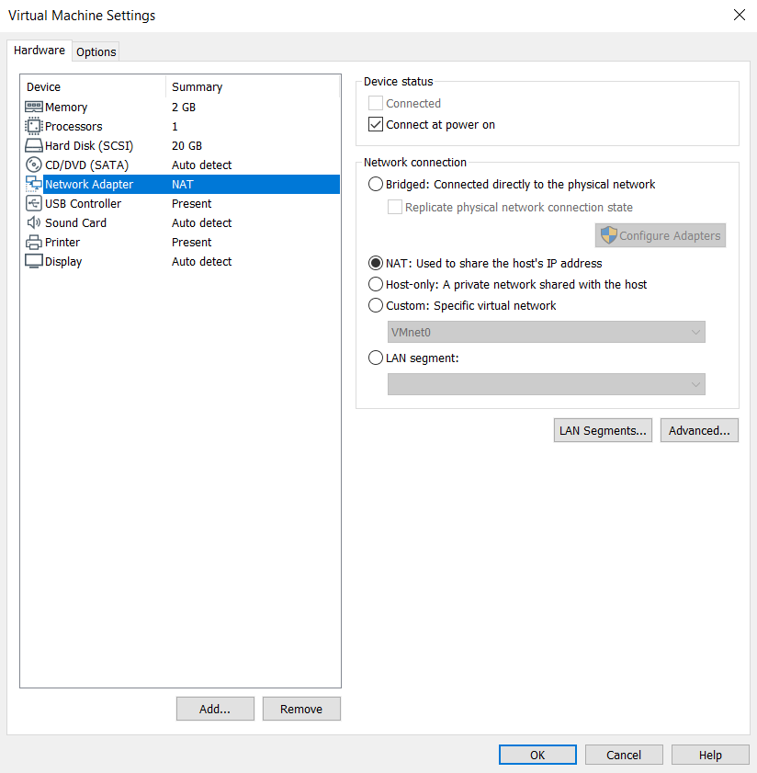
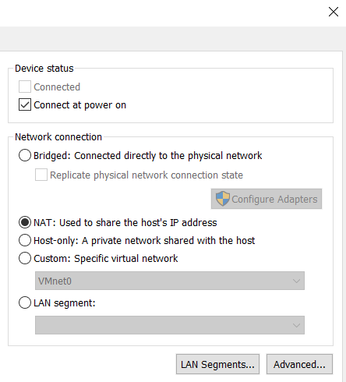
Hypervisor Network Settings
Hypervisors manage all resources and allocate based on virtual machine needs
Memory
Processors
Network Interfaces – Host Only, Bridged, NAT
USB Controller
Display

Slide 12

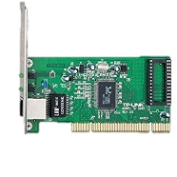
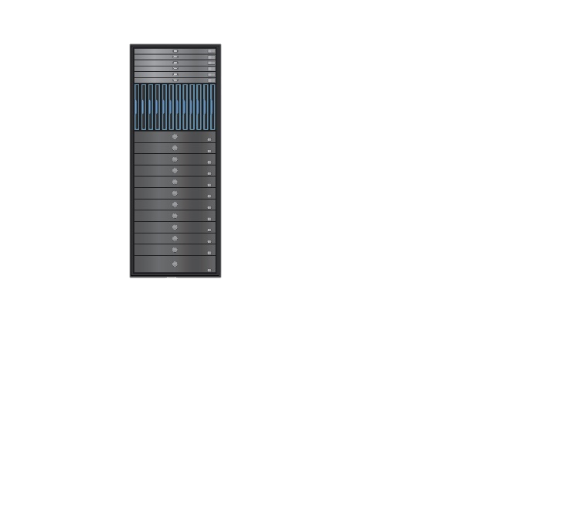

Bridged Network
Some forensic applications require direct connection to the network
IP addressees assigned to guests coincide with the network that the physical NIC is communicating with
There are some network considerations to consider when assigning a bridged interface:
Static IP Assignment / DHCP
10.10.10.4
10.10.10.3
Virtual
NICs
and
Switch
Host
10.10.10.0/16
10.10.10.2
Network
Physical
NIC
10.10.10.1
10.10.10.100

Slide 13
Host Only Network
Some forensic applications require complete isolations from external networks
Malware Analysis
IP addressees assigned to guests coincides only to the host IP network
10.10.10.4
10.10.10.3
Virtual
NICs
and
Switch
Host
No External
Network Connection
192.168.50.0/24
10.10.10.2
Network
Physical
NIC
10.10.10.1
10.10.10.100

Slide 14
Network Address Translation
Network Address Translation reduces the number of outward facing IP addresses in a traditional network and helps proxy internal IP addresses
When assigned as a NAT network, guests will have there own internal IP structure while requests from ext
10.10.10.4
50.1.1.1
10.10.10.3
60.1.1.1
10.10.10.100
200.1.1.4
External
Network
10.10.10.2
Virtual
NIC
Physical
NICs
10.10.10.1
70.1.1.1

Slide 15
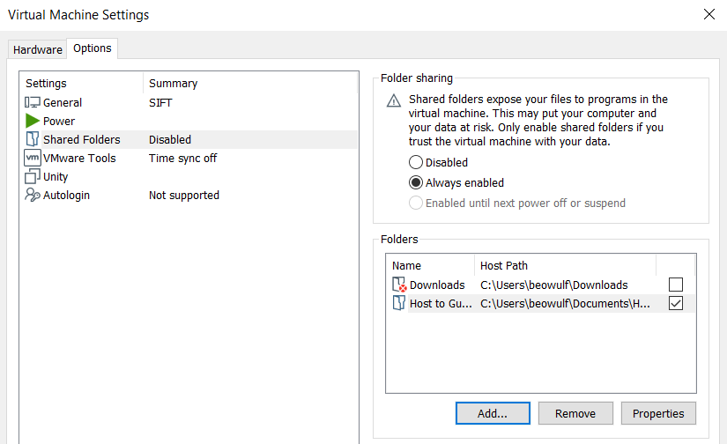
Hypervisor Shared Directories
When collecting forensic images from host to guest, it is advisable to create a shared directory
Image size can be limiting if a shared directory is not available

Slide 16
Storage Media Overview

Slide 17
International Standards
Throughout the course we will discuss numerous international and industry standards that aid in conducting forensic analysis
Request for Comments (RFC)
https://www.ietf.org/rfc
Examples
RFC 2616 - Hypertext Transfer Protocol
RFC 1035 – Domain Names
International Organization for Standardization (ISO)
https://www.iso.org/standards-catalogue/browse-by-ics.html
Examples
ISO 27001 - Information Technology - Security Techniques
ISO 27002 - Information Security Controls
International Electrotechnical Commission (IEC)
https://www.iec.ch/about/activities/standards.htm
Examples
IEC 23912 - Standard for Recordable DVD Media
IEC 60908 - Audio recording - CD Digital Audio System
IEC 10149 - Information technology CD-ROM
Many times ISO and IEC will be listed together
ISO/IEC 27001, ISO/IEC 27002, ISO/IEC 23912

Slide 18
File System Abstraction
Logical analysis of any file system should include definitions for:
Disk
Physical Storage Device
SCSI
SATA
SD
Partition
Logical separations for a disk
Partition: Single Disk
Volume: Multiple Disks
File System
Defines file layout and metadata on the partition
Each partition / volume has a file system
* Digital Forensics with Open Source Tools, Chapter 3

Slide 19
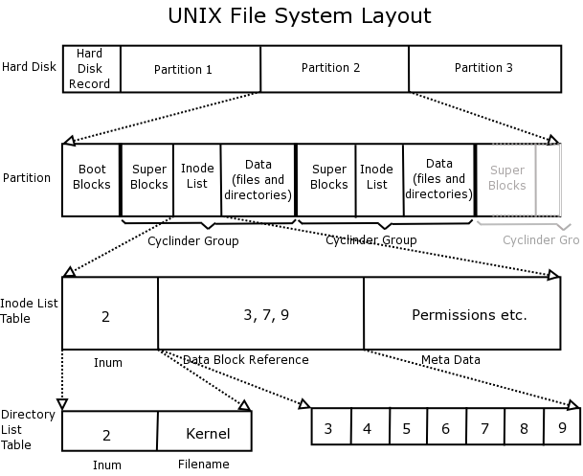
File System Abstraction (con’t)
File system model also includes:
Data Units
The smallest addressable data element
512 bytes → 4 KB
Metadata
Data about data units
Windows
File ID
Linux
Inode
File Name
User space naming
http://www.learnlinux.org.za/courses/build/internals/ch08s04.html

Slide 20
File System Abstraction
DISK
PARTITION
FILE SYSTEM
DATA UNIT
METADATA
FILE NAME

Slide 21

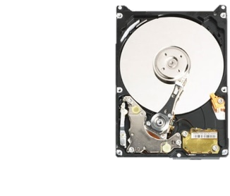
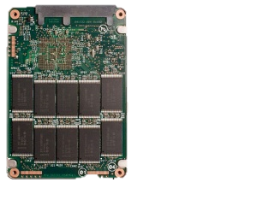

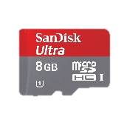
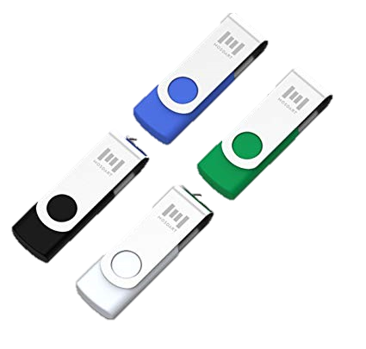
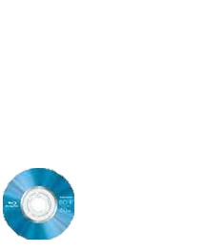
Mass Storage Devices
Mass storage divides into three main categories:
Magnetic Media
Non-Volatile Memory (Flash)
Optical Media
CD
DVD
Blue Ray
To effectively analyze media it is important to understand differences between different connectors used to communicate between media, devices, and the testing environment
SATA
eSATA
mSATA
IDE
Fibre Channel
NVME
USB
Thunderbolt

Slide 22

Hard Disk Drives
Traditional hard disks depend on physical geometry of the drive
Heads
Platters
Tracks
Sectors per track
Data location on the disk is derived utilizing Logical Block Addresses (LBA)
Recall that disk sectors are the smallest addressable data element
512 bytes → 4 KB (4Kn)
File deletion only unlinks references to data
Hard disk drives do have “Host Protected Areas” that are inaccessible to users

Slide 23
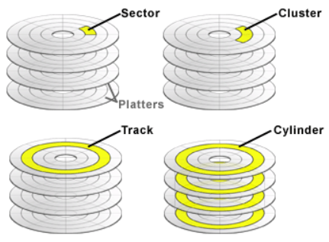
Standard Hard Disk Drive Geometry
https://www.sweetscape.com/010editor/manual/EditingDrives.htm

Slide 24
Standard Hard Disk Drive
Forensic Considerations
When conducting a forensic analysis, there are forensic considerations when dealing with magnetic media
Physical vs. Logical Disks
Physical – Geometry
Logical – Partitions / Volumes
Address Mapping
Cylinder-Head-Sector (CHS)
Logical Block Address (LBA)
Each physical sector is assigned a logical sequential number creating a virtual address for disk access
Standard hard disk drives have a fixed addressing scheme between logical and physical blocks
Unallocated space
Unallocated space can contain previously written data which can be used during forensic analysis

Slide 25
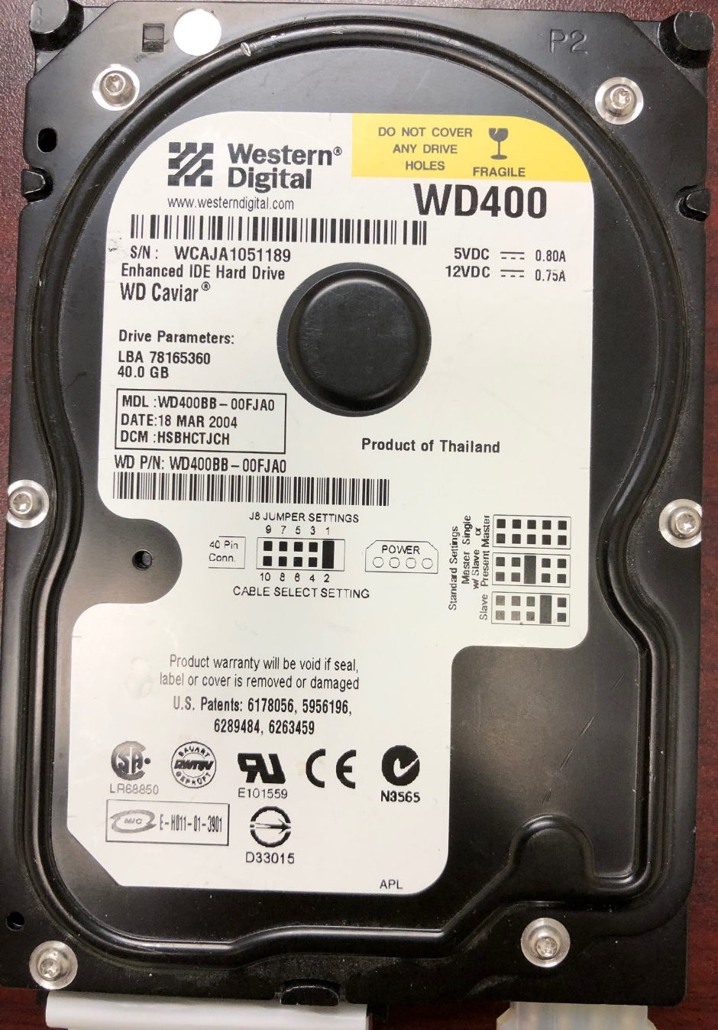
Hard Disk Drive Space
LBA 78165360
78,165,360 Sectors
512 Bytes / Sector
40,020,664,320 Bytes
1,073,741,824 Bytes / GiB
37.3 GiB

Slide 26
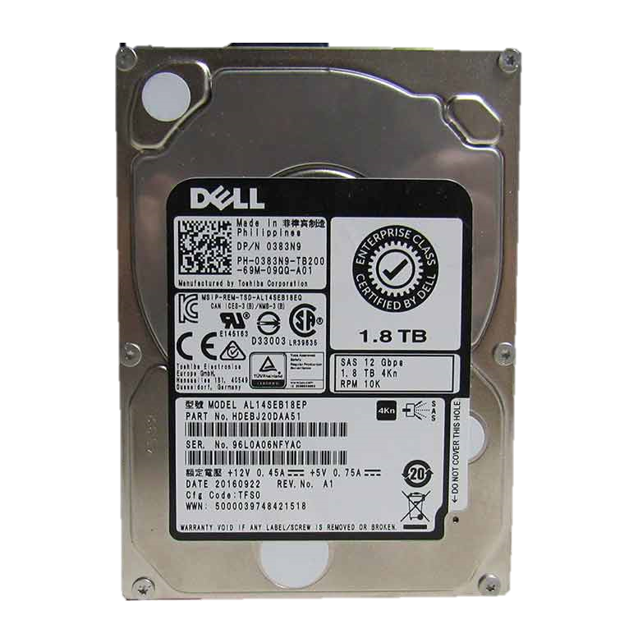

Advanced Format 4Kn
International Disk Drive Equipment and Materials Association (IDEMA) Developed a standard to move sectors from 512 to 4096 bytes
Most vendors started moving to the new standard started in 2009, but many disks today still emulate 512 byte sectors
512e Disks

Slide 27
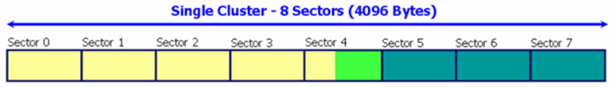

4Kn Forensic Considerations
The use of 4Kn disks can cause difficulties in image acquisition due to a number of factors
Western Digital Advanced Format 512e disk offsets
Disk jumper settings
Automated sector alignment
When using 4Kn enabled disks, RAM slack and File Slack are the same since sectors are 4 KB versus 512 bytes
Sector - 512 bytes
File
Length
File
Slack
Cluster
Slack
Sector – 4KB
File
Length
File
Slack

Slide 28
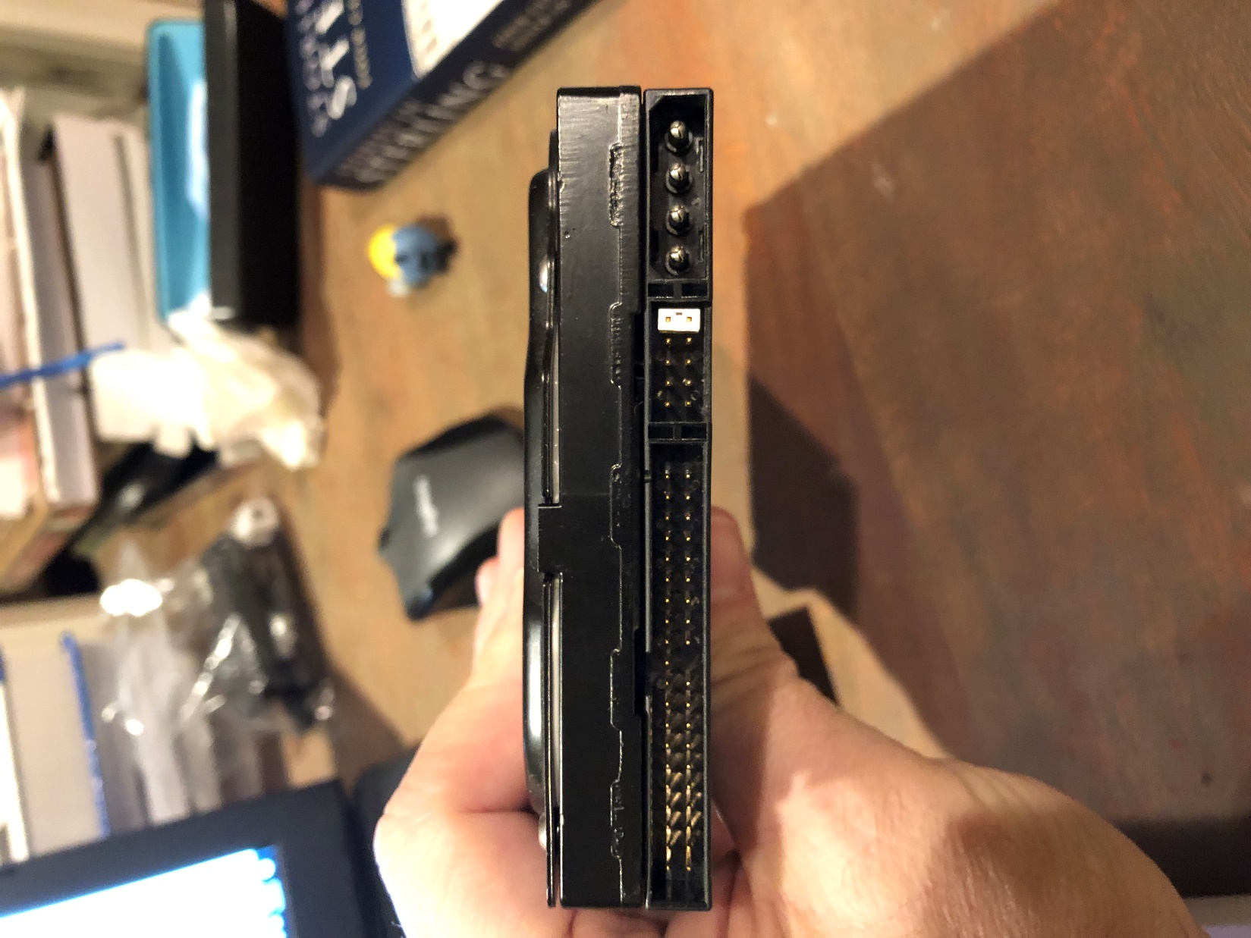
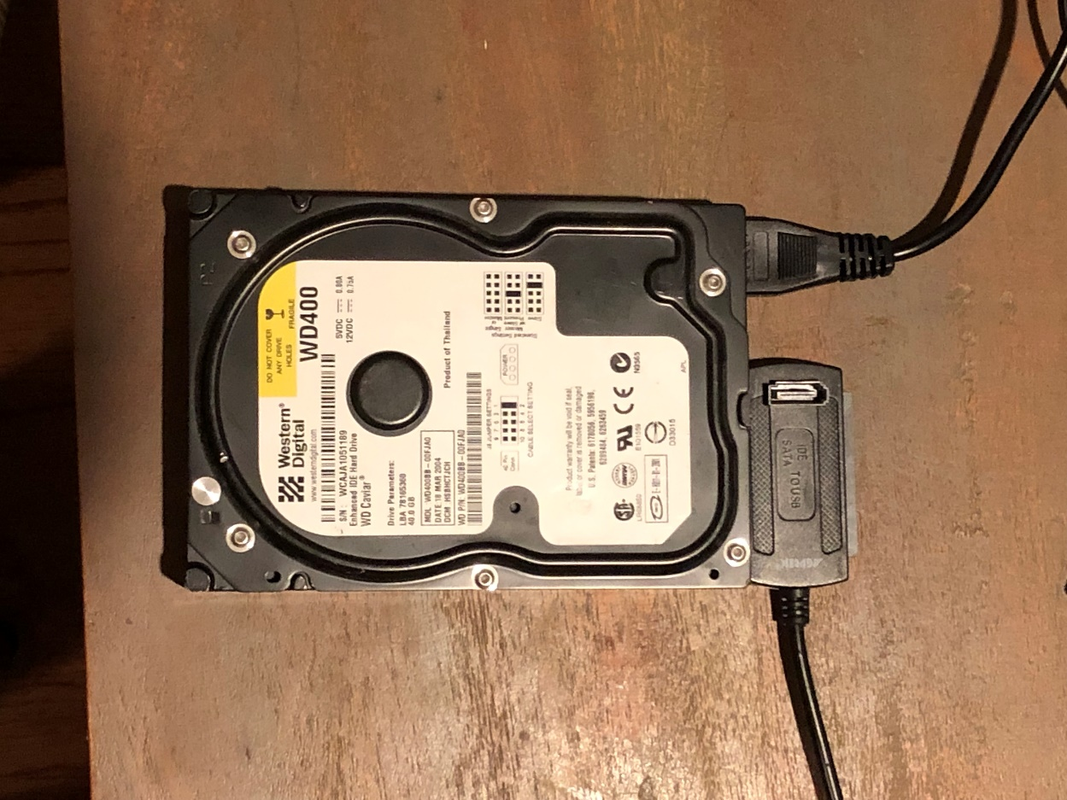
Hard Disk Drive Connectors
Integrated Drive Electronics
Molex Power

Slide 29
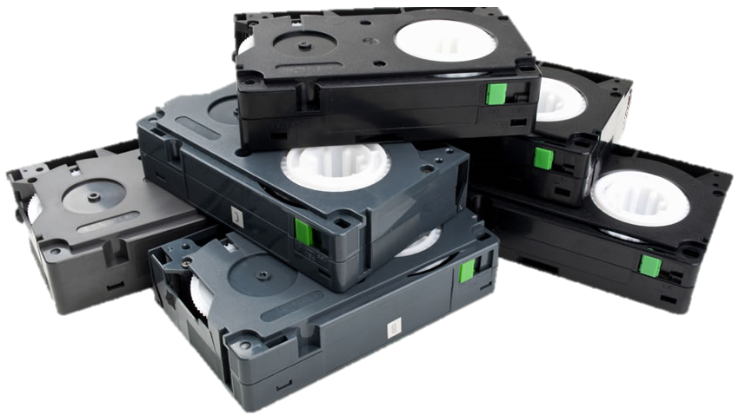
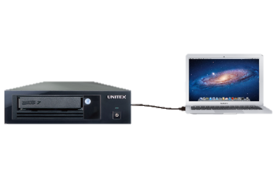
Magnetic Tapes
Generally used for backup and archiving purposes in enterprise environments
Magnetic tapes provide a stable media that can be used for long-term offline storage
Sequential read and write, no random access
Each file contains its own file system
Read and written with SCSI commands
Once written to, each archive is marked with an end of Data (EOD) marker

Slide 30
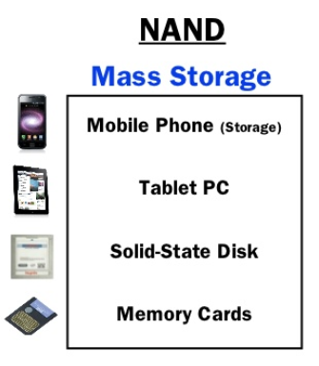
Non-Volatile Memory
Flash Erase Electrically Erasable Programmable Read-Only Memory (Flash)
Transistors making up mass storage devices can be composed of AND, NOR, or NAND gates
NAND provides benefits over the other transistor types for storage devices
NAND memory cells configured with Flash Translation Layer (FTL) allow configuration similar to hard drives
Performance benefits vs. hard drives
https://www.slideshare.net/ruchiusha/07flash-memory-technology

Slide 31
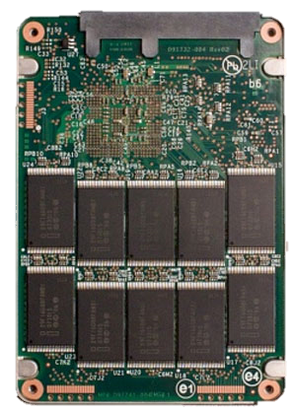
Solid State Drives
Solid state drives are fundamentally different than traditional hard disks
NAND-based storage does not suffer from physical wear
TRIM command clears unallocated blocks
SSDs are usually configured with Self-Monitoring, Analysis, and Reporting Technology (SMART)

Slide 32
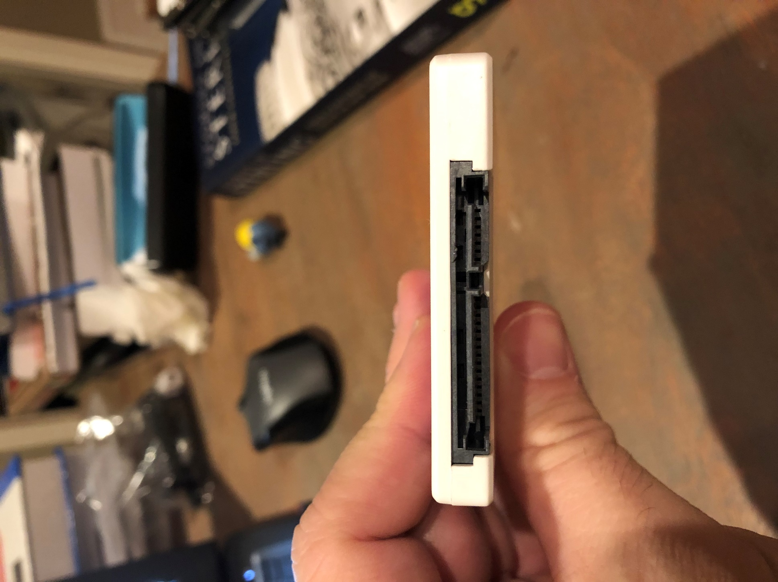
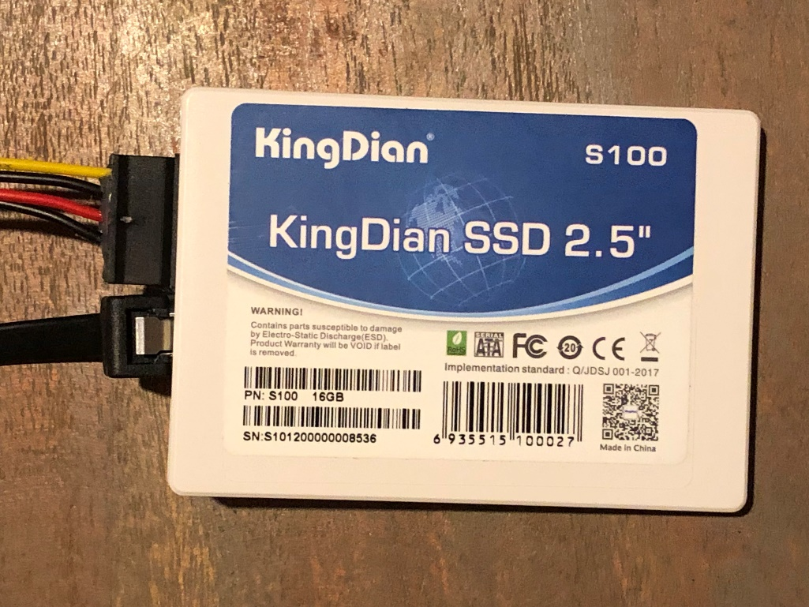
Solid State Drive Connectors
SATA Power
Serial Advanced
Technology Attachment

Slide 33
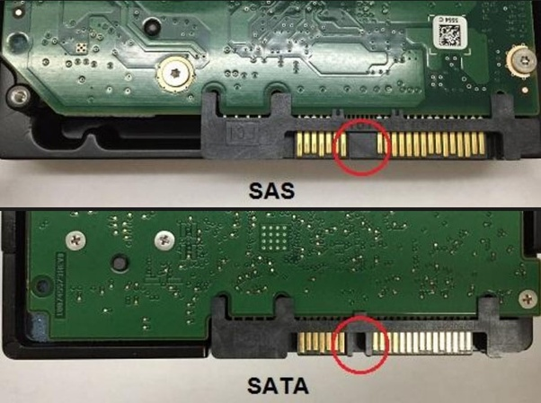
SAS vs. SATA
Serial
Attached
Small
Computer
System
Interface
Serial
Advanced
Technology
Attachment
https://www.quora.com/What-is-the-port-difference-between-SSD-SAS-and-SSD-SATA

Slide 34
Solid State Drive
Forensic Considerations
When conducting a forensic analysis, there are forensic considerations when dealing with non-volatile memory
Unallocated space
Unlike standard hard disk drives, unallocated space is usually erased with TRIM in preparation for future writes which prevents recovery of data
Address Mapping
Unlike standard hard disk drives, solid state drives use dynamic addressing of logical to physical blocks

Slide 35
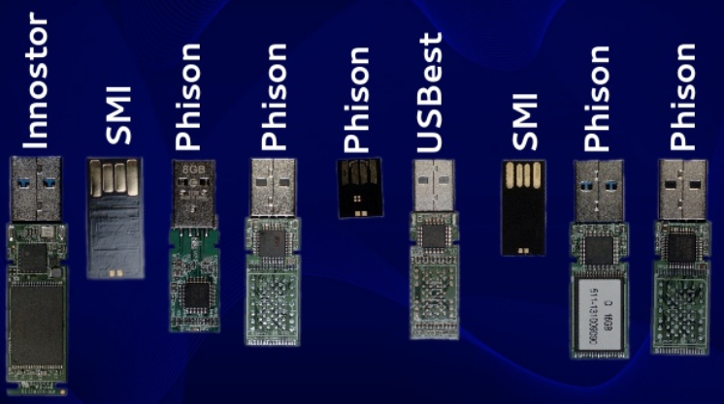
USB Flash Drives
Universal Serial Bus
NAND or NOR technology
USB flash drives can be formatted with most common file systems:
FAT
exFAT
NTFS
extX
https://www.slideshare.net/xabean/controlling-usb-flash-drive-controllers-expose-of-hidden-features

Slide 36
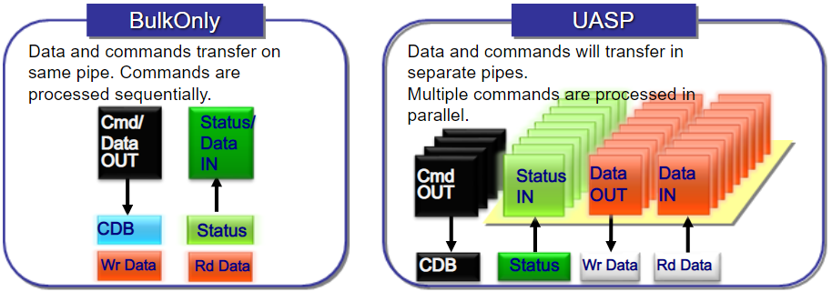
USB SCSI Protocols
USB accesses storage devices with two modes:
Bulk Only Transport (BOT) mode
Legacy, lower performance mode
USB Attached SCSI Protocol (UASP) mode
UAS Protocol
Higher performance over BOT mode and improves:
Asynchronous Processing
Improved Task Control
Also known as:
USB3 Boost
USB3 Turbo
USB3 Extreme
https://slideplayer.com/slide/5806013

Slide 37
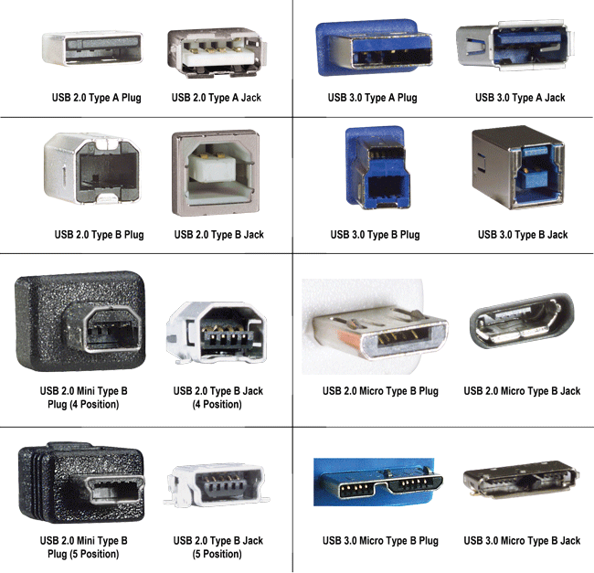
USB Flash Drive Connectors
http://www.l-com.com/content/USB-Tutorial.html

Slide 38
USB Flash Drive
Forensic Considerations
Flash drives can be configured with any filesystem depending on application
FAT
exFAT
NTFS
HFS
extX
Potential hiding techniques will be dependent on file system used
USB flash drives are coded with:
Vendor ID (VID)
Product ID (PID)
https://usb-ids.gowdy.us/read/UD

Slide 39
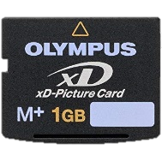
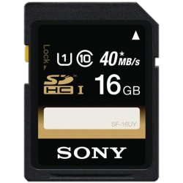
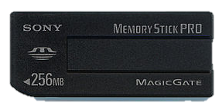
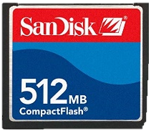
Removable Memory Card Types
Removable memory cards are used extensively in numerous applications and have multiple formats
xD
Extreme Digital
Digital Photo Applications
MMC / SD
MultiMediaCard / Secure Digital
General Flash Memory
M2 / μSD
Memory Stick Micro – Micro Secure Digital
General Flash Memory
PRO – Duo – Duo Pro
Sony proprietary
General Flash Memory
CF
CompactFlash

Slide 40
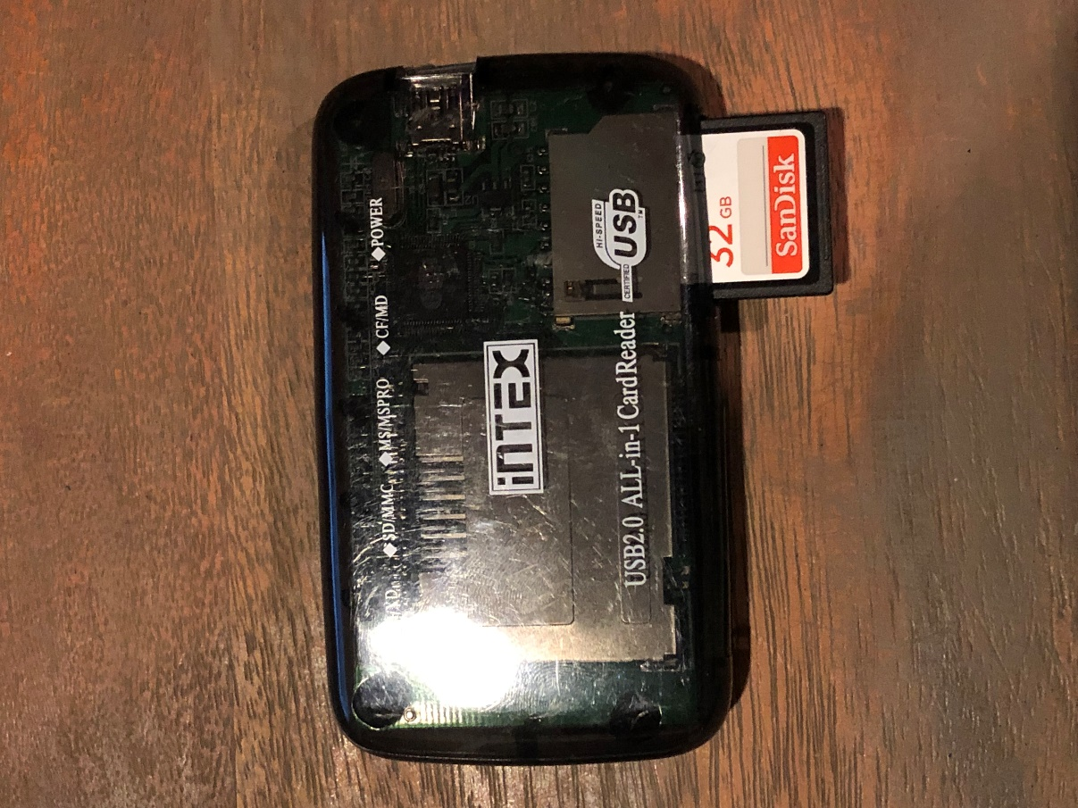
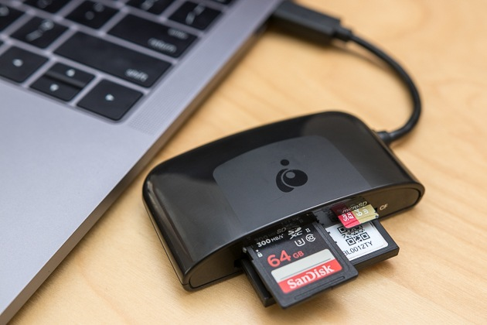
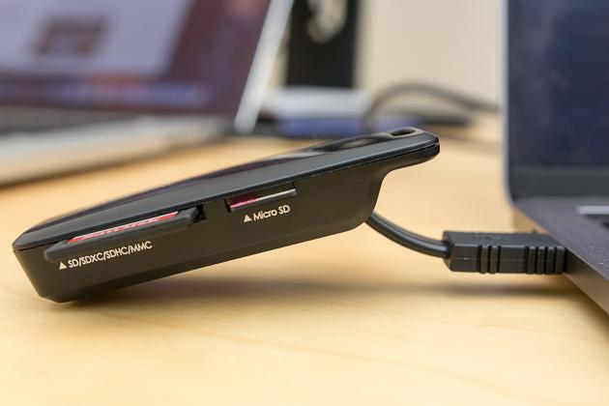
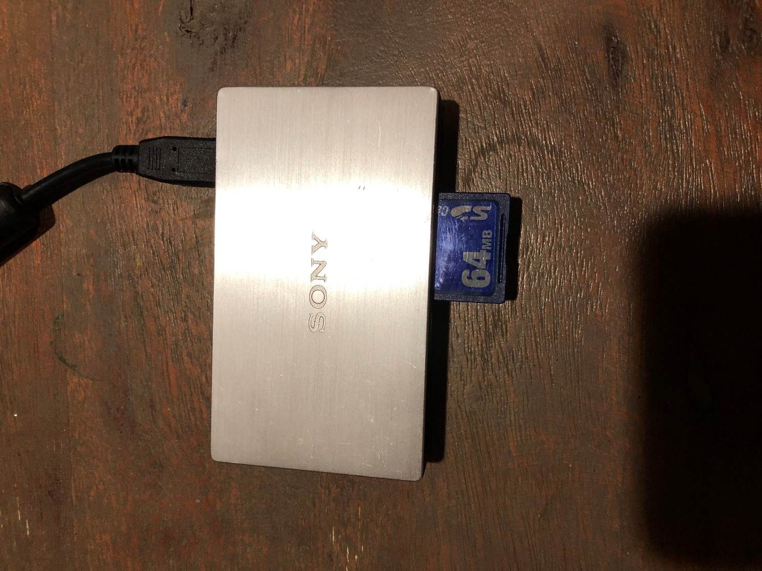
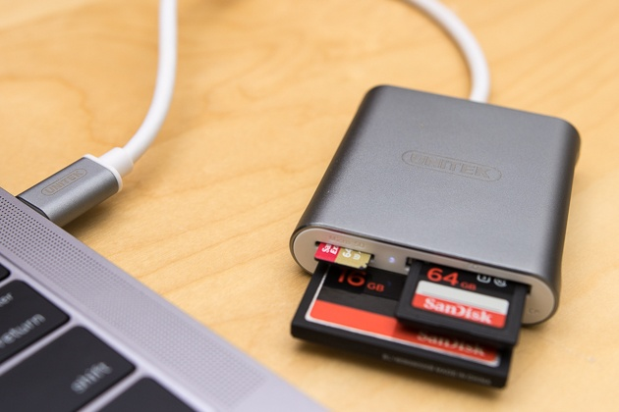
Removable Memory Card Readers
https://thewirecutter.com/reviews/best-sd-card-readers

Slide 41
Optical Storage Media
Optical storage media have different methods of reading and writing:
Read-Only (ROM)
Write-Once Read Many (WORM)
Read-Writable (RW)
Compact Disc Types
CD-DA – Compact Disc – Digital Audio
IEC 60908 - Audio recording - CD Digital Audio System
CD-ROM – Compact Disc – Read Only Memory
IEC 10149 - Information technology CD-ROM
CD-R – Compact Disc – Recordable (Single Write)
CD-RW – Compact Disc – Re-Writable (Multiple Writes)
ISO 9660 is the standard filesystem for
High Sierra
ISO 9660 – Updated High Sierra
Joliet – ISO 9660 for Win 95+
HFS - Mac
Rock Ridge – ISO 9660 for POSIX
El Torito – Bootable Disks

Slide 42
Compact Disc
Forensic Considerations
Unlike standard HDDs which have End of Data (EOD) and Host Protected Areas (HPA) that prevent direct user access, optical media can be read but CD filesystems may require specific analysis tools
Optical disk contain linear sectors with each being 2048 bytes in size
Write blockers are not necessary when analyzing CD-ROMs
In contrast to other storage media, there are media unique identifiers for optical storage
International Federation of Phonographic Industry (IFPI)
Source Unique Identifier (SID)
Physical disc stamp indicating production facility
Recorder Identification Code (RIC)
Links a burned CD to the drive that created it

Slide 43
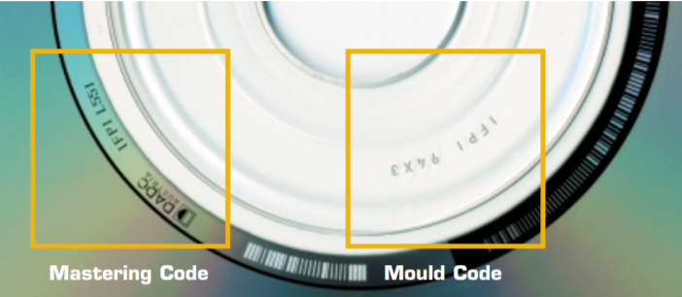
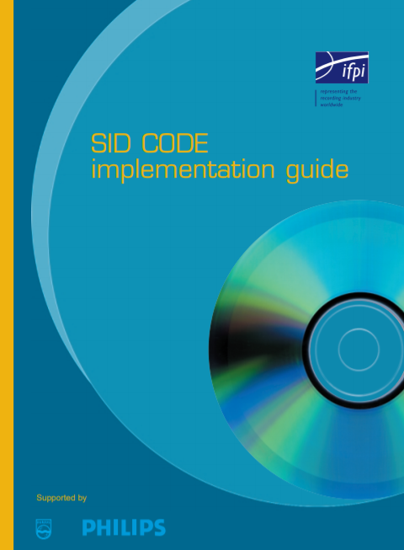
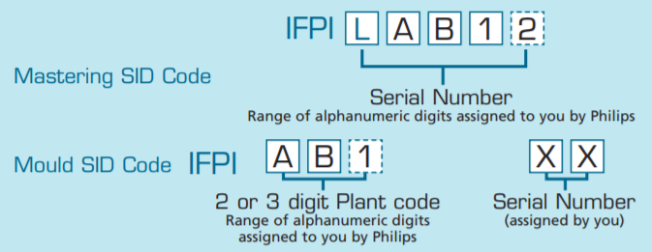
Source Unique Identifiers
SID Code Reference

Slide 44
Digital Versatile Discs
DVDs are single of double sided with a 120-mm diameter and 1.2-mm thickness and composed of 2048 byte sectors
Can be configured with Digital Rights Management (DRM) protection measures included encryption
DVD types:
DVD standards have similarities to CD standards namely:
DVD-Video
DVD-ROM
DVD-R – DVD Recordable (Single Write)
DVD-RW – DVD Re-Writable (Multiple Writes)
In contrast to CD standards, DVD standards also include:
DVD-RAM
DVD that can be written to and erased repeatedly, but only accessed with a DVD-RAM drive
DVD+R
DVD Recordable (Single Write)
DVD+RW
DVD Re-Writable (Multiple Writes)
DVDs use Universal Disk Format (UDF) filesystem
Replacement for ISO9660

Slide 45
Blue-Ray Discs
Just like CD and DVD discs, blue-ray is composed of 2048 byte sectors
Blue-Ray disc (BD) types:
BD-ROM
BD-R – Blue-Ray Recordable (Single Write)
BD-RE - Blue-Ray Re-Writable (Multiple Write)
BD-XL - Blue-Ray Double Capacity Re-Writable (Multiple Write)
Just like DVDs, blue-ray discs use Universal Disk Format (UDF) filesystem
Blue-Ray Discs can be configured with Digital Rights Management (DRM) protection measures included encryption

Slide 46
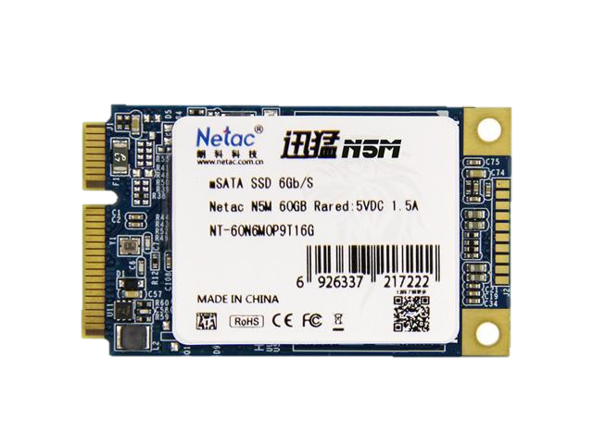
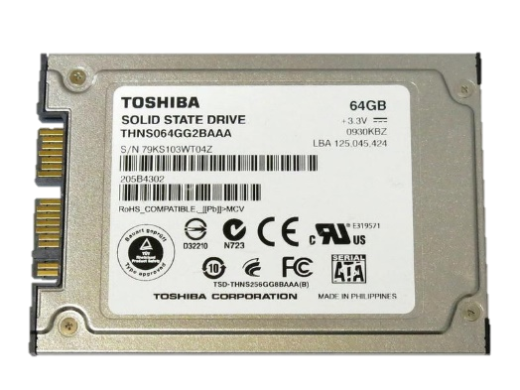
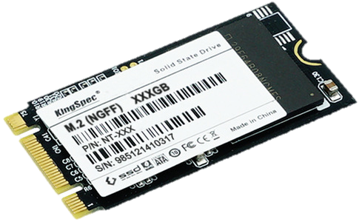

Additional Media Interfaces
Mini-SATA (mSATA)
Micro SATA
M.2
SATA Express

Slide 47


Other Media Connectors
Fibre Channel (FC)
Non-Volatile Memory Express (NVME) with Peripheral Component Interconnect Express (PCI-E)
https://www.lascon.co.uk/SAN-Cables-and-Connectors.php

Slide 48



NVME Forensic Considerations
Although NVME-based disks are block devices, they cannot be accessed in the same method as a SCSI-based disk since the protocols are different
/dev/sdX vs. /dev/nvmeXnX
NVME use is relatively new and there have been additions to write-blockers to collect NVME-based disk images

Slide 49
Media Detection and Configuration

Slide 50



External Media Detection
Connect drive to host
Connect drive to guest
Available devices
Auto mount vs. read only
Write blocking

Slide 51
Media Detection and Access
Now that we have an initial introduction of the type of media that may be necessary to analyze, we will introduce some initial tools built into SIFT
The following Linux locations and commands provide information about attached media:
/dev
Device file repository
dmesg
Kernel level driver messages
lsblk
List block devices
blockdev
Block device system calls
lsscsi
List SCSI disk attributes
lsusb
List USB buses
fdisk
Disk format
df
Disk space
hdparm
Display and set drive parameters
hexdump (xxd)
Dump file contents in hex

Slide 52

/dev
/dev directory contains device drivers
Additional device information is available in /sys
Devices are characterized as either:
Character devices - c
ttyX - Terminal
snapshot - System memory snapshot device
Block Devices - b
loopX - Loopback device
sdX - SCSI disk device
nvmeXnX – NVME disk device
Linux Allocated Devices Reference

Slide 53
File System Abstraction
DISK
PARTITION
FILE SYSTEM
DATA UNIT
METADATA
FILE NAME

Slide 54

Disks and Partitions
Utilizing the file system abstraction we can identify disks and their associated partitions
SCSI device files listing disks and partitions
Disks
/dev/sda – First Disk
/dev/sdb – Second Disk
Partitions
/dev/sda1 – First Disk, First Partition
/dev/sdb1 – Second Disk, First Partition
/dev/sdb2 – Second Disk, Second Partition
/dev/sdb3 – Second Disk, Third Partition

Slide 55
dmesg
Print or control the kernel ring buffer which is responsible for recording kernel level driver messages
All system changes can be displayed in real time
Examples:
dmesg
Default output
dmesg –T | grep sd
Displays messages relative to disk events with local time and filters on scsi disk devices

Slide 56


dmesg – Time and Drive Information
dmesg -T
dmesg –T | grep sd

Slide 57
dmesg Event Order
usb
scsi
sd

Slide 58

dmesg – Sector Sizes

Slide 59

dmesg - USB BOT vs. UASP Mode
USB BOT Interface
usb-storage
USB UASP Interface
uas
The legacy BOT mode does not affect forensic collection or hashes from those devices
BOT
UASP

Slide 60

lsblk
lsblk lists all available block devices
Reads the sysfs filesystem and udev database
If the udev not available or lsblk is compiled without udev it reads LABELs, UUIDs and filesystem types from the block device
Root permissions are necessary
sudo lsblk
Lists all block devices, except RAM disks, in a tree-like format by default

Slide 61

lsblk – Filesystem Information
lsblk –f lists all currently mounted filesystems
Output for partition is shown as a tree

Slide 62

lsblk – Device Owner, Group, and Mode
lsblk –m lists device owners, groups, and modes
Modes shows permissions for owners, groups, and world

Slide 63
blockdev
blockdev is a system call directly to block devices
blockdev switches include:
--getalignoff
Get alignment offset
--getfra
Get filesystem readahead in 512-byte sectors
--getsize64
Print device size in bytes.
--rereadpt
Reread partition table
--report
Create a report of all block devices

Slide 64

blockdev - Report
Reports show read only status, sector size, block size, starting sectors, and overall disk size

Slide 65


lsscsi
While lsblk shows all block devices the use of lsscsi shows SCSI specific device attributes
Disks
Printers
SIFT Drive
SCSI CD-ROM
External Drive
[Host Adapter ID:SCSI Channel:ID:Logical Unit Number]
dir: /sys/bus/scsi/devices/33:0:0:0
[/sys/devices/pci0000:00/0000:00:11.0/0000:02:03.0/usb1/1-1/1-1:1.0/host33/target33:0:0/33:0:0:0]

Slide 66

lsusb
lsusb is a utility for displaying information about USB buses in the system and the devices connected to them
Switch examples:
lsusb -v
Verbose output
lsusb –s 001
Show only devices in a specified bus
lsusb –t
Dump physical USB device hierarchy as a tree

Slide 67

fdisk
fdisk, short for format disk, is a tool that can be used to list, create, and manipulate partition tables of attached disks
Each partition shows the start and end point which will become important during the partition and file analysis of each disk
Single Partition
Multiple Partition

Slide 68

df
df displays file system disk space usage

Slide 69

Viewing Raw Disk Data
In order to properly analyze disk images, data, and metadata it is necessary to understand how partitions are composed and how they can be parsed
One sector of the FAT32 disk

Slide 70
HPA and DCO
Host Protected Area (HPA)
Introduced in ATA/ATAPI-4 standard that allowed system vendors to allocate reserved space outside of the BIOS & OS
HPA examples include:
Disk Utilities
System Recovery Data
Diagnostic Tools
Boot Sector Code
The operating system does not have access to HPA and requires firmware
Device Configuration Overlay (DCO)
Introduced in ATA/ATAPI-6 standard that allows controls of disk features and made it easier to provide disk support and drive replacement across multiple vendors
If used with HPA, DCO must be established first
When conducting a forensics analysis, it is important to identify HPA and DCO usage as it has been used to hide malicious code and data
dmesg
hdparm

Slide 71

hdparm
hdparm shows and sets hard disk parameters
ATA/ATAPI-6 Standard
Logical Block
Addressing

Slide 72

hdparm – Disk Features
Self-Monitoring
Analysis and
Reporting Technology
DCO Set

